Slide 1
Live Good
Centurians Research Project

Slide 2
Table of
Contents
I. Problem Statement
II. Progress Overview
III. Dataset Overview
IV. Survey Analysis
Personal background
Life Style
Life Evaluation and Personality
Objective Examination and Illness
V. Model Recalibration
VI. What’s Next

Slide 3
Problem Statement
We are studying centenarian populations across the world to uncover the factors contributing to their longevity.
The project focuses on characterizing these populations, identifying key longevity predictors, and drawing actionable insights for public health

Slide 4
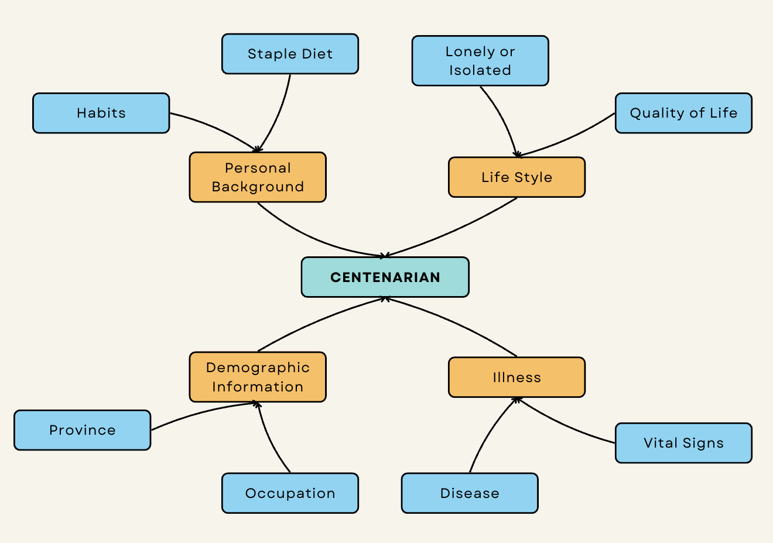
Challenges to study Centenarian Population?
Too many confounding variables
Absence of a standardized dataset
Insufficient lifestyle data across multiple countries

Slide 5
Progress Overview
Explored to get different datasets

Slide 6
Dataset Overview

Slide 7
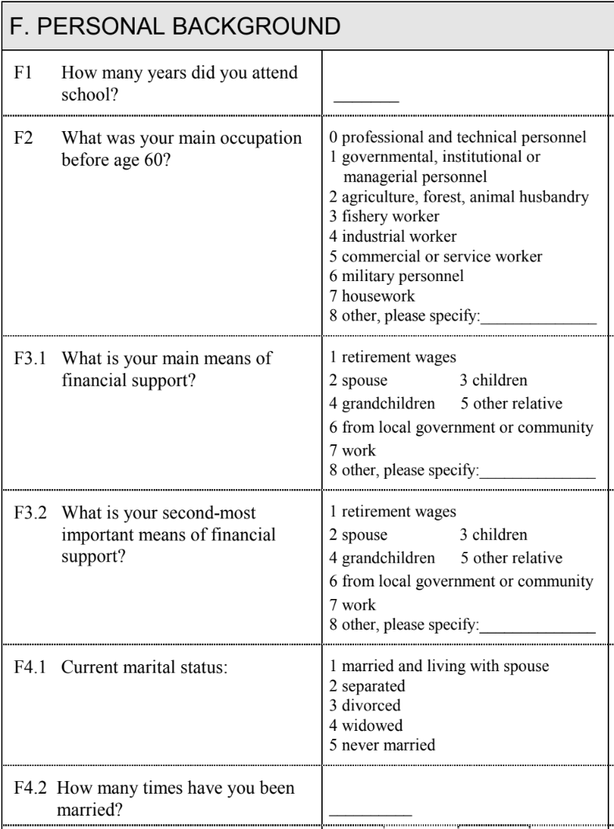
Questionnaire Overview - Personal Background
Life Evaluation Survey: Conducted in waves from 1998 to 2011.
Objective: To assess the personal background of participants.
Insights:
Understanding participants' demographics, education, marital status and financial support.
Reveals patterns in healthcare equity, generational shifts and role of social and familial support in shaping well being and longevity.

Slide 8
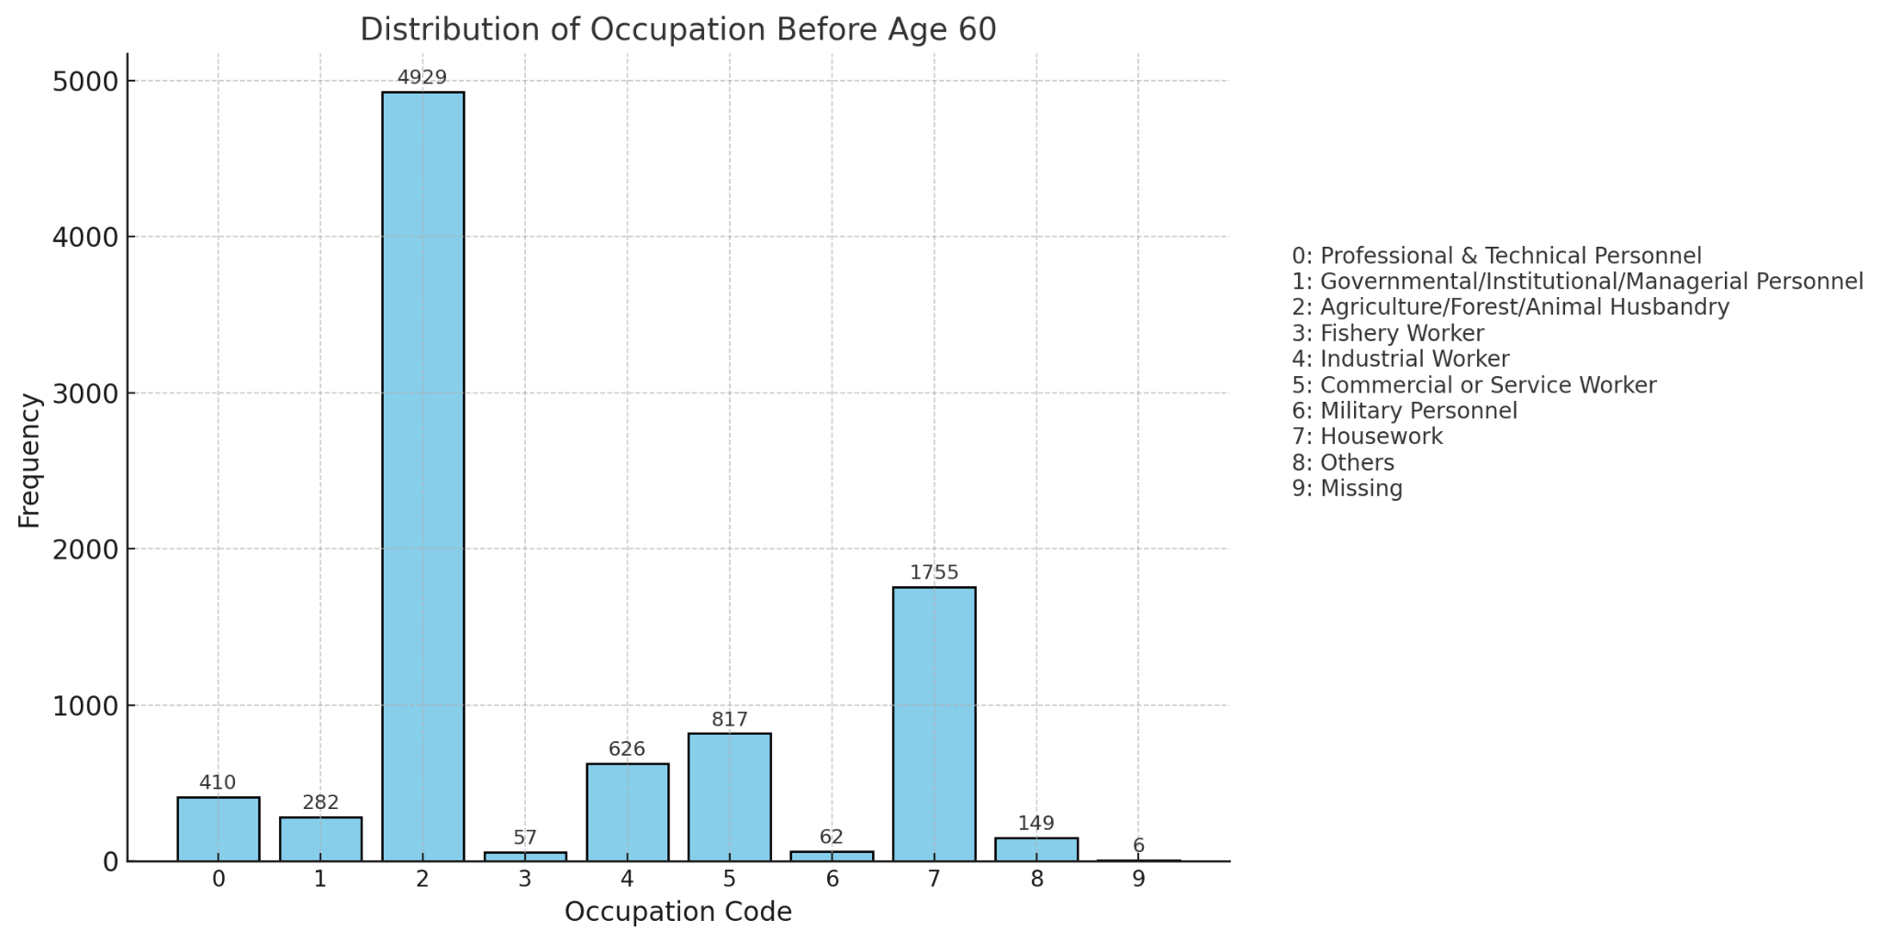
Analysis - Personal Background

Slide 9
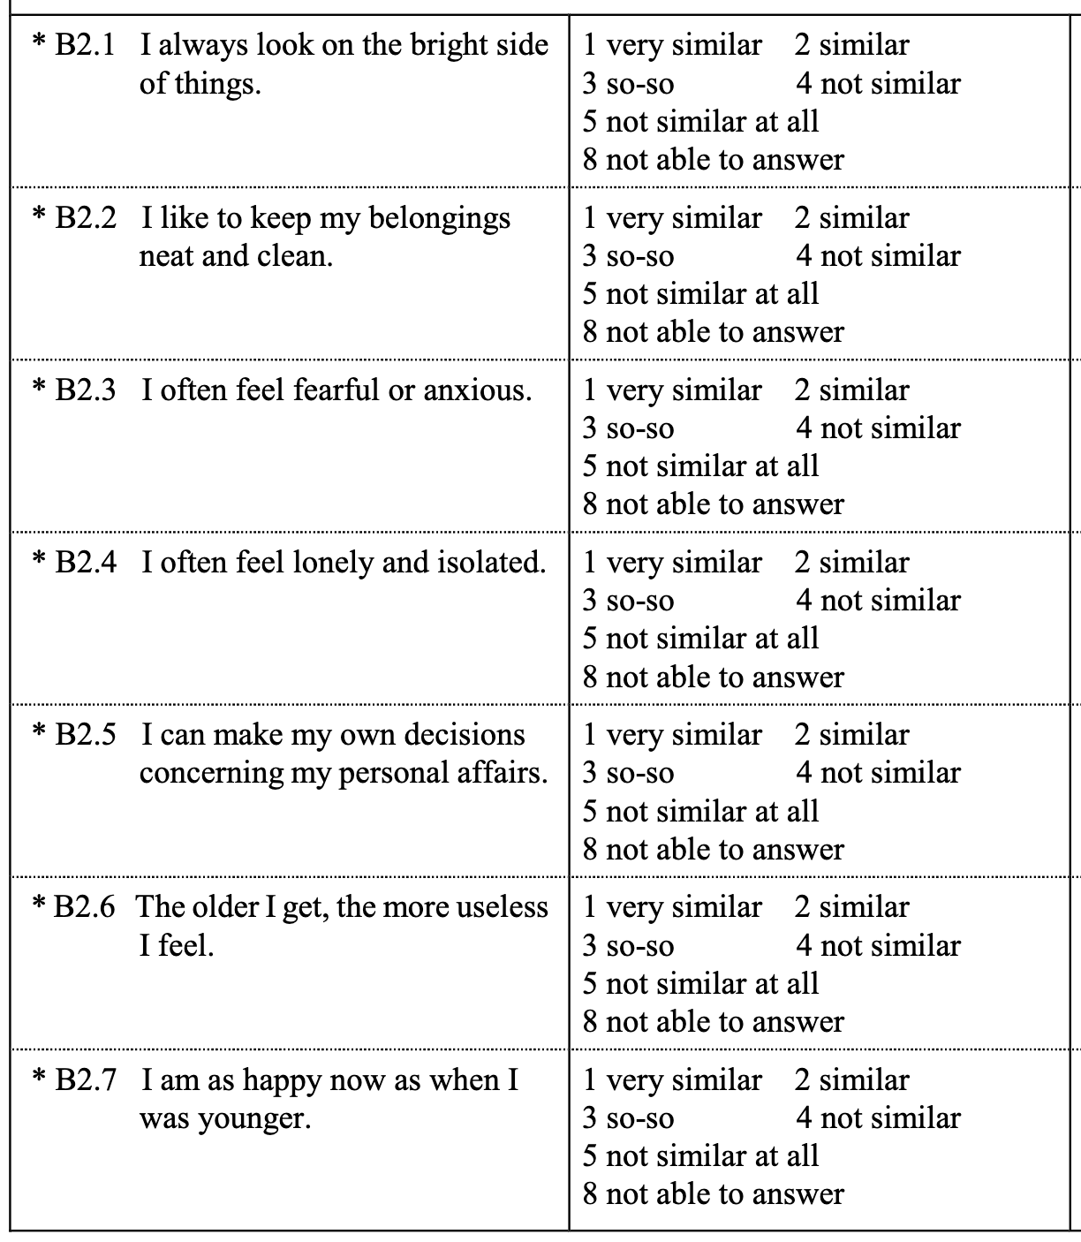
Questionnaire Overview - Life Evaluation and Personality
Life Evaluation Survey: Conducted in waves from 1998 to 2011.
Objective: To assess the personality traits of participants.
Insights:
Understanding participants' perceptions of life and their environment.
Identifying traits that motivated or isolated participants from others.

Slide 10
Analysis - Personal Background
Dominance of Agriculture:
The majority of individuals (54.2%, 4929 people) were involved in agriculture, forestry, or animal husbandry before age 60, indicating that these occupations were the backbone of employment.
Significant Proportion in Housework:
Housework accounted for 19.3% (1755 people), showing that a substantial portion of the population was engaged in domestic activities.
Moderate Contributions:
Industrial workers (6.9%, 626 people) and commercial/service workers (9.0%, 817 people) represented notable yet smaller groups.
Rare Occupations:
Categories like military personnel (0.7%, 62 people), fishery workers (0.6%, 57 people), and others (1.6%, 149 people) were less common.

Slide 11
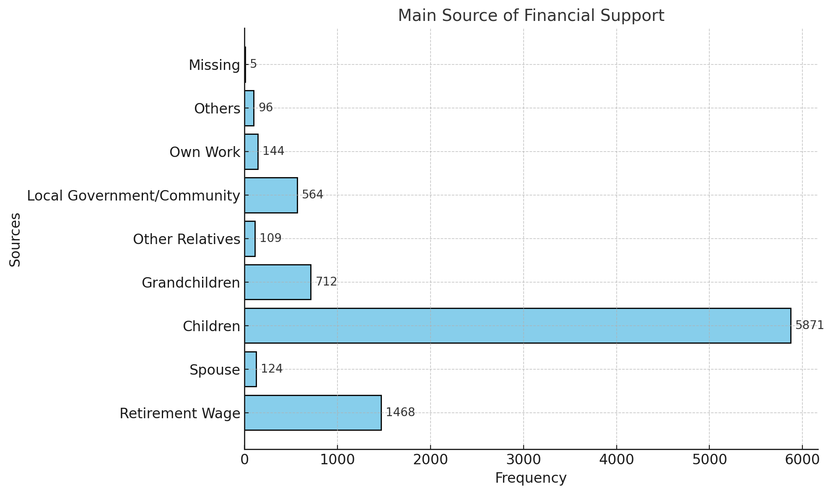
Analysis - Personal Background

Slide 12
Analysis - Personal Background
Key Insights:
Children are the primary source of financial support, accounting for 64.6% (5871 individuals)
Retirement Wage follows, contributing 16.1% (1468 individuals)
Grandchildren provide support for 7.8% (712 individuals)
Minor Sources:
Spouse: 1.4% (124 individuals).
Local Government/Community: 6.2% (564 individuals).
Other Relatives and Own Work contribute less than 2% each.

Slide 13
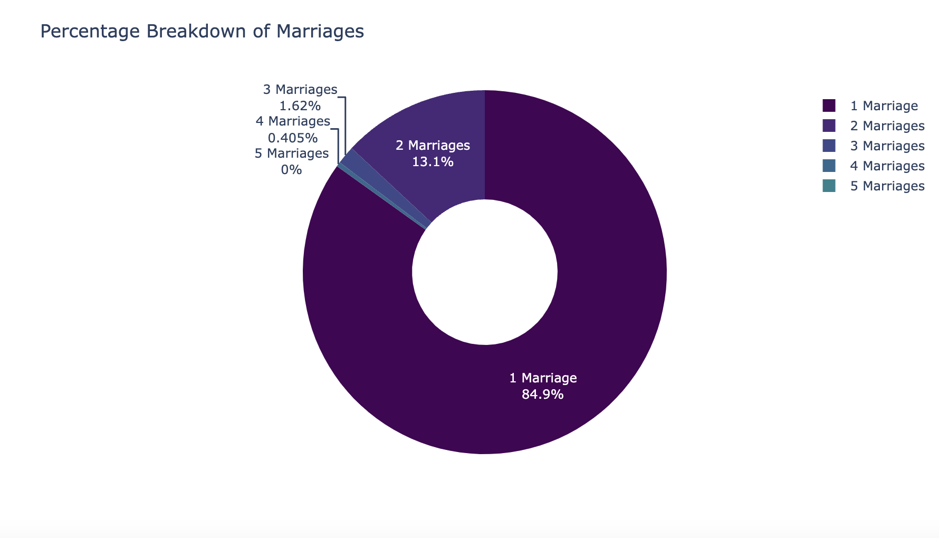
Analysis - Personal Background

Slide 14
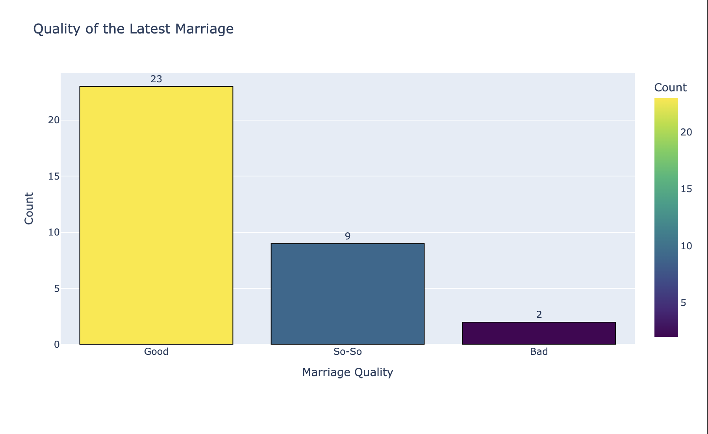
Analysis - Personal Background
Insights:
A small fraction of participants provided valid evaluations of their latest marriage, with most reporting a positive experience ("Good").
Negative responses ("Bad") are extremely rare, suggesting a generally favorable perception of the latest marriage among those who remarried.

Slide 15
Analysis - Personal Background
Single Marriage Prevalence: A vast majority (83.8%) of participants have been married only once. This reflects a societal norm or preference for monogamous, lifelong marriages.
Multiple Marriages: A smaller proportion reported being married more than once:
12.9% had two marriages.
1.6% had three marriages.
0.4% had four marriages.
0.0% (2 cases) reported five marriages.
Not Applicable: 1.2% of participants (112 cases) indicated that this question did not apply to them, likely due to never having been married.

Slide 16
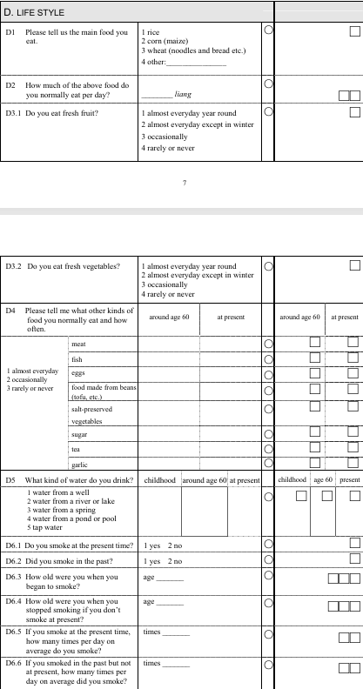
Questionnaire Overview - Life Style
Life Evaluation Survey: Conducted in waves from 1998 to 2011.
Objective: To assess the food habits and lifestyle
of participants.
Insights:
Understanding participants diet choices and habits
Exploring lifestyle choices that influenced social connections and aging

Slide 17
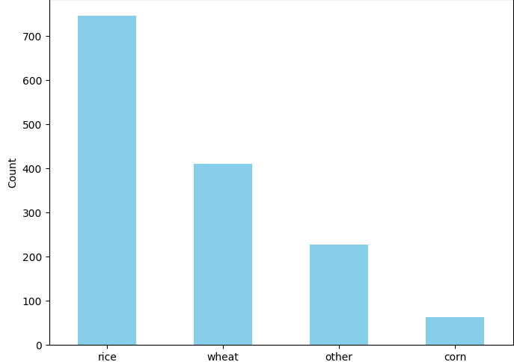
Main Food Preferences among Centenarians
Rice is the predominant food choice among centenarians, far outpacing other options.
Wheat and other grains are also consumed, while corn is the least preferred.

Slide 18
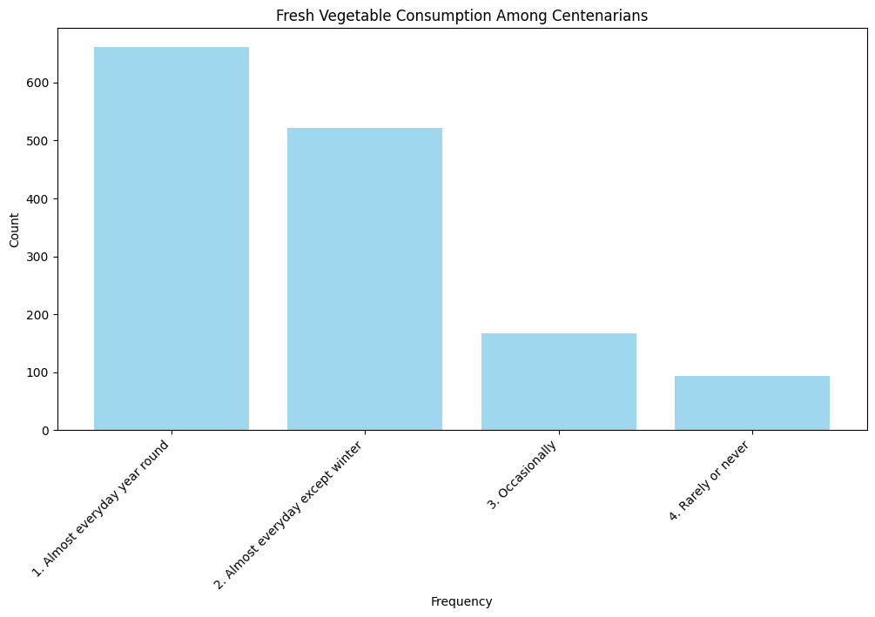
Fresh Vegetable Consumption among Centenarians
A majority of centenarians consume fresh vegetables almost daily, even in winter
Occasional and rare consumption is significantly lower, emphasizing the importance of vegetables in their diets

Slide 19
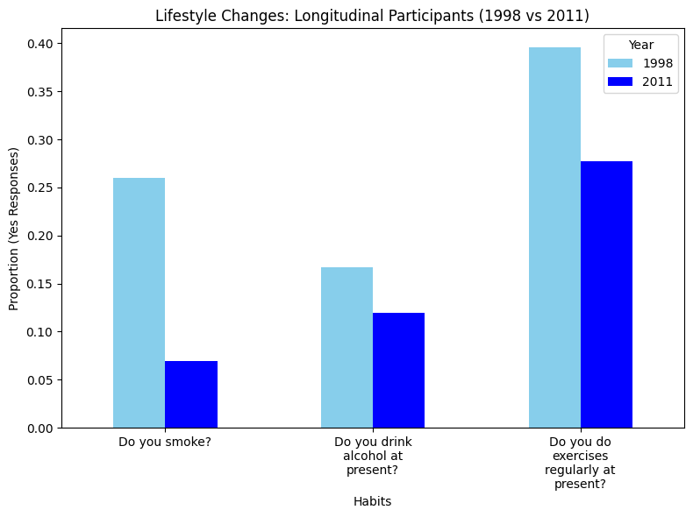
Lifestyle Changes (1998 vs 2011)
Significant decline in smoking and alcohol consumption habits over the years.
Increase in regular exercise indicates growing awareness of healthy living.

Slide 20
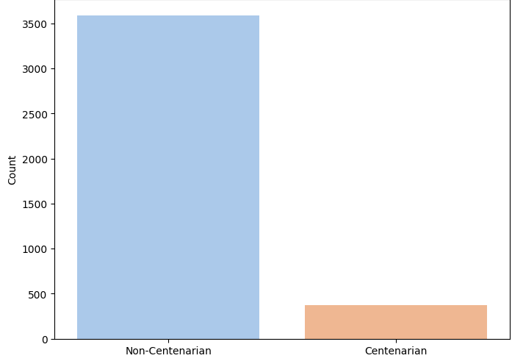
Comparison of Centenarians vs Non-Centenarians who Smoked or Drank in the past
Non-centenarians who smoked or drank in the past far outnumber centenarians with the same history.
The stark difference suggests lifestyle factors could play a significant role in longevity.

Slide 21
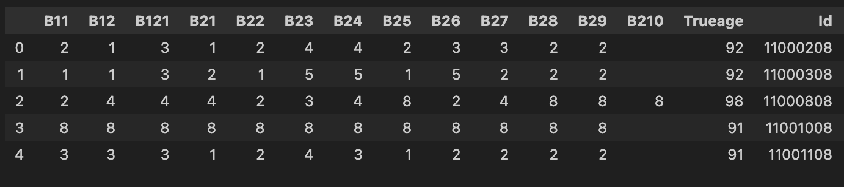
How does raw data look like for Life Evaluation and Personality Survey
Lifestyle Survey Dataset: Contained 13 categorical questions.
Feature Structure: Each question had 8 categories, ranging from 1 (strongly inclined) to 8 (strongly declined).

Slide 22

Data Preprocessing Life Evaluation and Personality Survey
Personality Evaluation Features: 8 features mapped to suitable codes.
Physical Health Indicators: Quality of Life and Reported Health provide insights into the participant’s physical health.
Emotional Status Indicators: Fearful and Useless with Age reflect the participant’s emotional well-being.

Slide 23

Processing Life Evaluation and Personality Survey Data
Age Categories: Divided the dataset into the following categories:
70-80, 80-90, 90-100, 100-110, 110+
Objectives:
Kullback-Leibler Divergence:
Apply KL Divergence to assess if the distributions are significantly different across categories.
Quantify the degree of difference between the distributions.

Slide 24
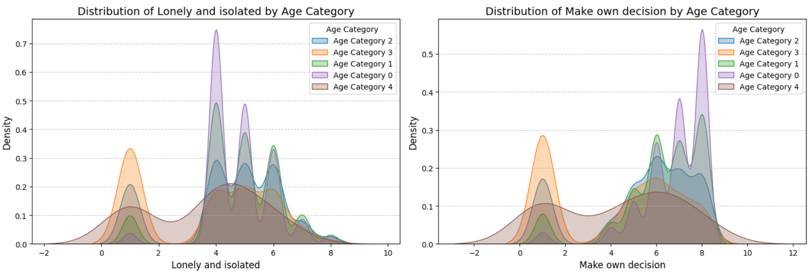
Observations from the Analysis - Life Evaluation and Personality
Kernel Density plots for Lonely(B24) and Isolated and Make own decision(B25)
KL Statistics (On Avg for each year)
 | YEAR - 1998 | YEAR - 2000 | YEAR - 2002 | YEAR - 2005 | YEAR - 2008 | YEAR - 2011
B24 | 0.57 | 0.65 | 0.44 | 0.38 | 0.43 | 0.55
B25 | 0.67 | 0.98 | 0.46 | 0.21 | 0.89 | 0.45

Slide 25
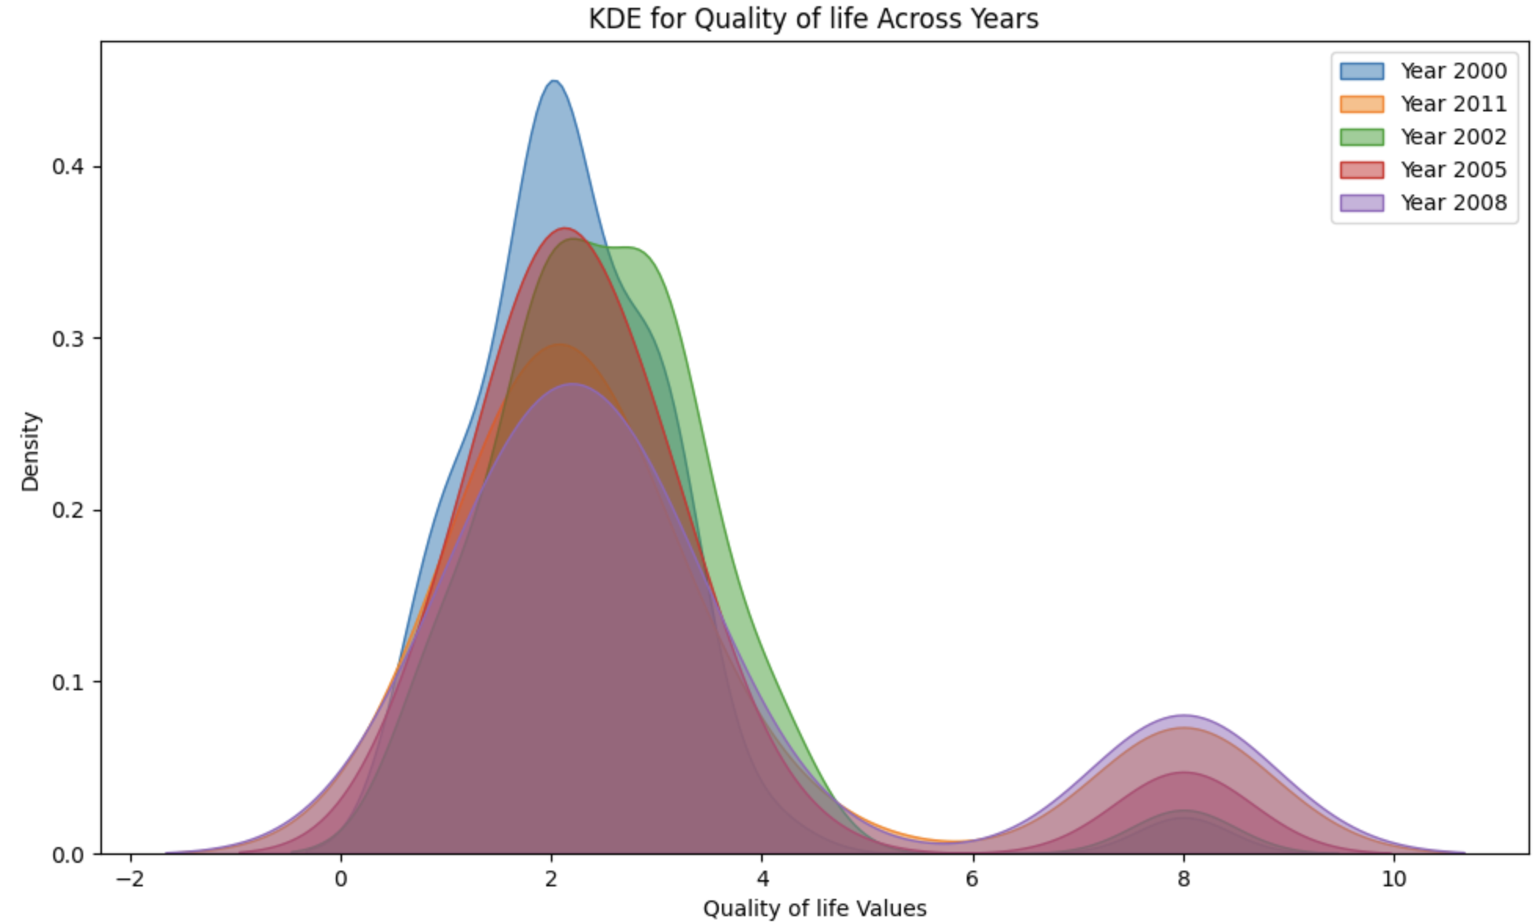
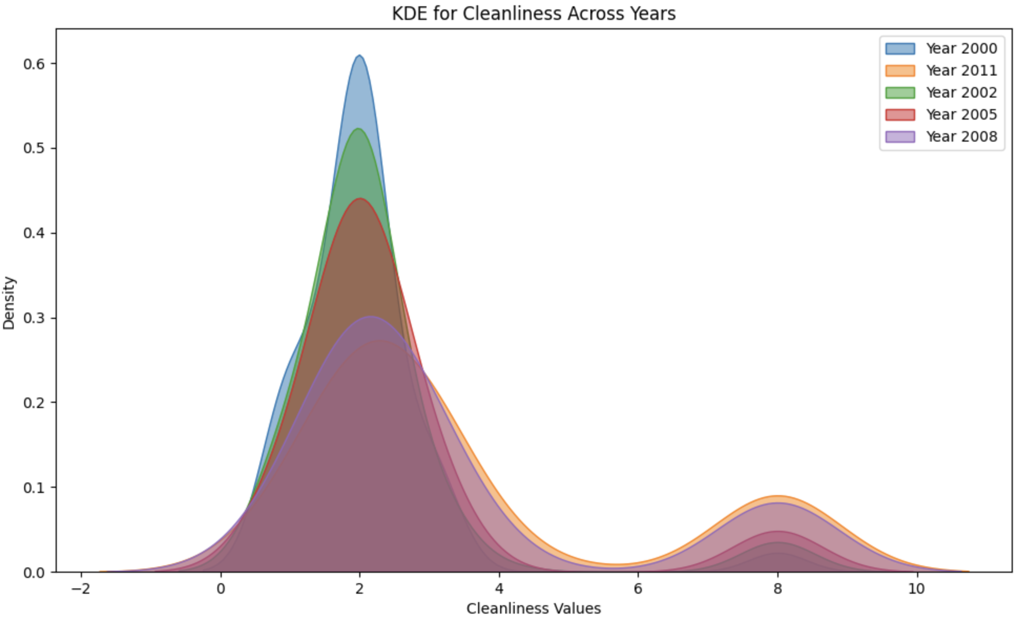
How the participants perform across the Years- Life Evaluation and Personality
KL Statistics: On avg for each year
 | YEAR - 1998 | YEAR - 2000 | YEAR - 2002 | YEAR - 2005 | YEAR - 2008 | YEAR - 2011
B11 | 0.32 | 0.57 | 0.77 | 0.21 | 0.17 | 0.61
B22 | 0.31 | 0.88 | 0.36 | 0.35 | 0.62 | 0.49

Slide 26
Key Takeaways - Life Evaluation and Personality
Age Groups [70-80] and [110+] have the most dissimilar distributions
Age Groups [70-80], [80-90], [90-100] showed similar characteristics for all the waves
Some of the below features were key discriminating factors for the respective years
In 1998 - Lonely and Isolated | Look on the bright side of the things
In 2002 - Feel Useless with Age | Make Own Decisions
In 2005 - Make Own Decisions | Be Happy as Younger
In 2008 - Lonely and Isolated | Make Own Decisions
Thus, observed the Loneliness and Decision Making are some of the most contributing factors to differentiate the age categories

Slide 27
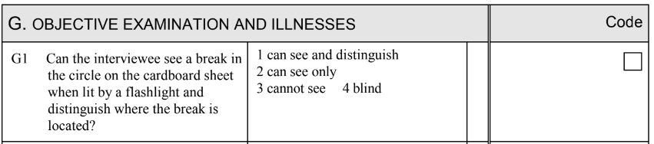
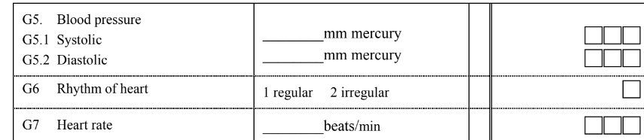
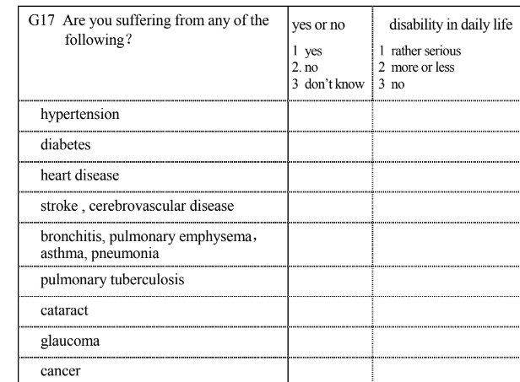
Questionnaire Overview - OBJECTIVE EXAMINATION AND ILLNESSES ATTENTION
Illness Survey: Conducted in waves from 1998 to 2011.
Objective: To evaluate the participants' physical health and identify prevalent illnesses among the elderly population through clinical and self-reported metrics.
Insights:
Aging Trends: Increased prevalence of chronic illnesses and functional decline with age, especially in centenarians.
Centenarian Resilience: Unique traits or behaviors enabling longevity despite health challenges.

Slide 28
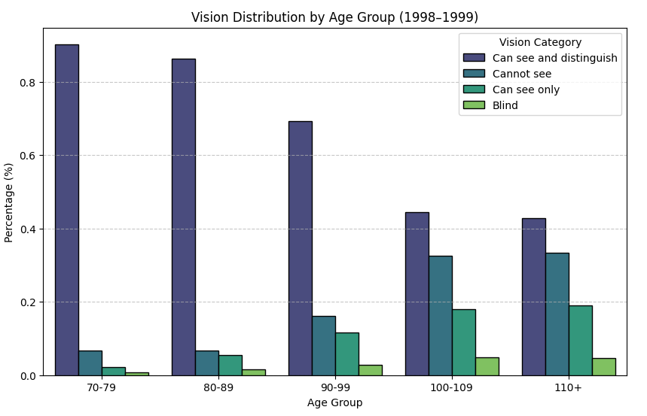
VISION ANALYSIS
The objective of the vision analysis was to understand how vision status varies across different age groups and changes over time.
The vision analysis focused on assessing the distribution of vision abilities among different age groups and tracking trends across multiple survey years.
Participants' vision was categorized into four distinct groups: "Can see and distinguish," "Can see only," "Cannot see," and "Blind." These categories provided insights into the varying levels of vision impairment within the population

Slide 29
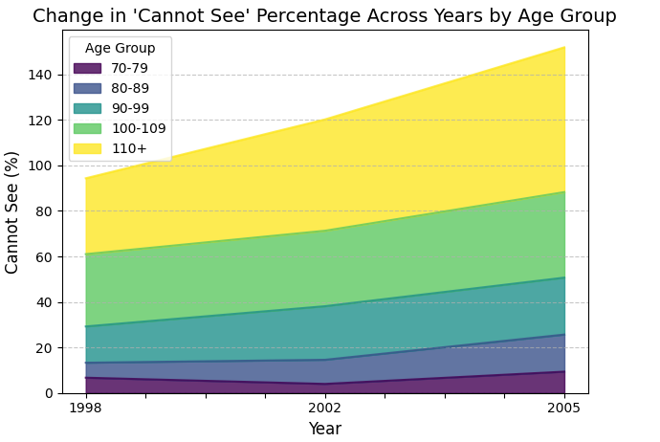
Key Insight:
As the years progress, the percentage of centenarians (aged 100+) who "Cannot See" significantly increases, indicating a decline in vision health among the oldest age groups.
Interestingly, this trend occurs despite a decrease in the total number of centenarians over time. This suggests that while fewer individuals are reaching extreme old age, those who do are experiencing greater rates of vision impairment.

Slide 30
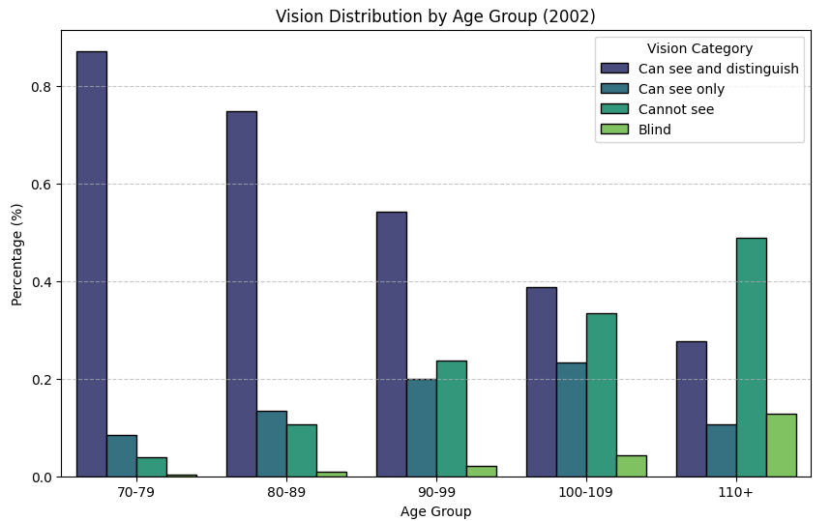
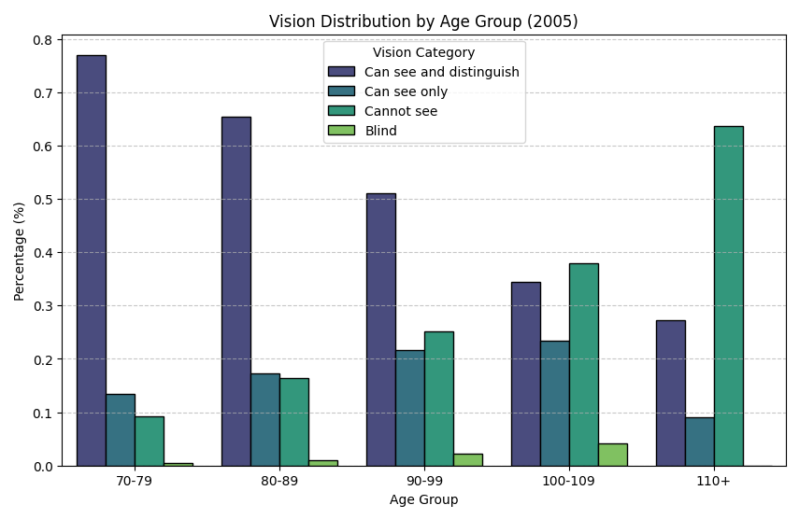

Slide 31
Model Recalibration
Hypothesis: We wanted to explore particularly how a single model trained on a specific population could be utilized for a different population with the same set of features

Slide 32
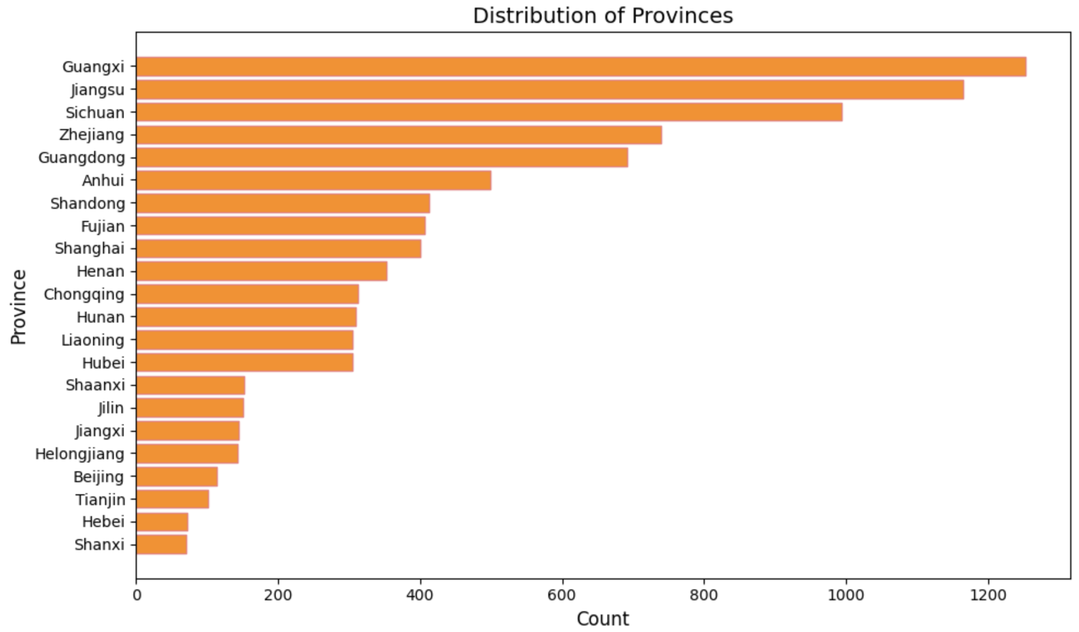
Model Recalibration
Experiment Setting: Sampled data from the year 1998 and grouped them on the basis of province.
Number of Provinces: 22
Randomly Sampled Feature Set
Fresh Fruit Consumption
Quality of Life
Suffering from any disease
Sex
Smoking Habits
Heart Rhythm
Surrounding Cleanliness
Fresh Vegetables Consumption
Population Distribution

Slide 33
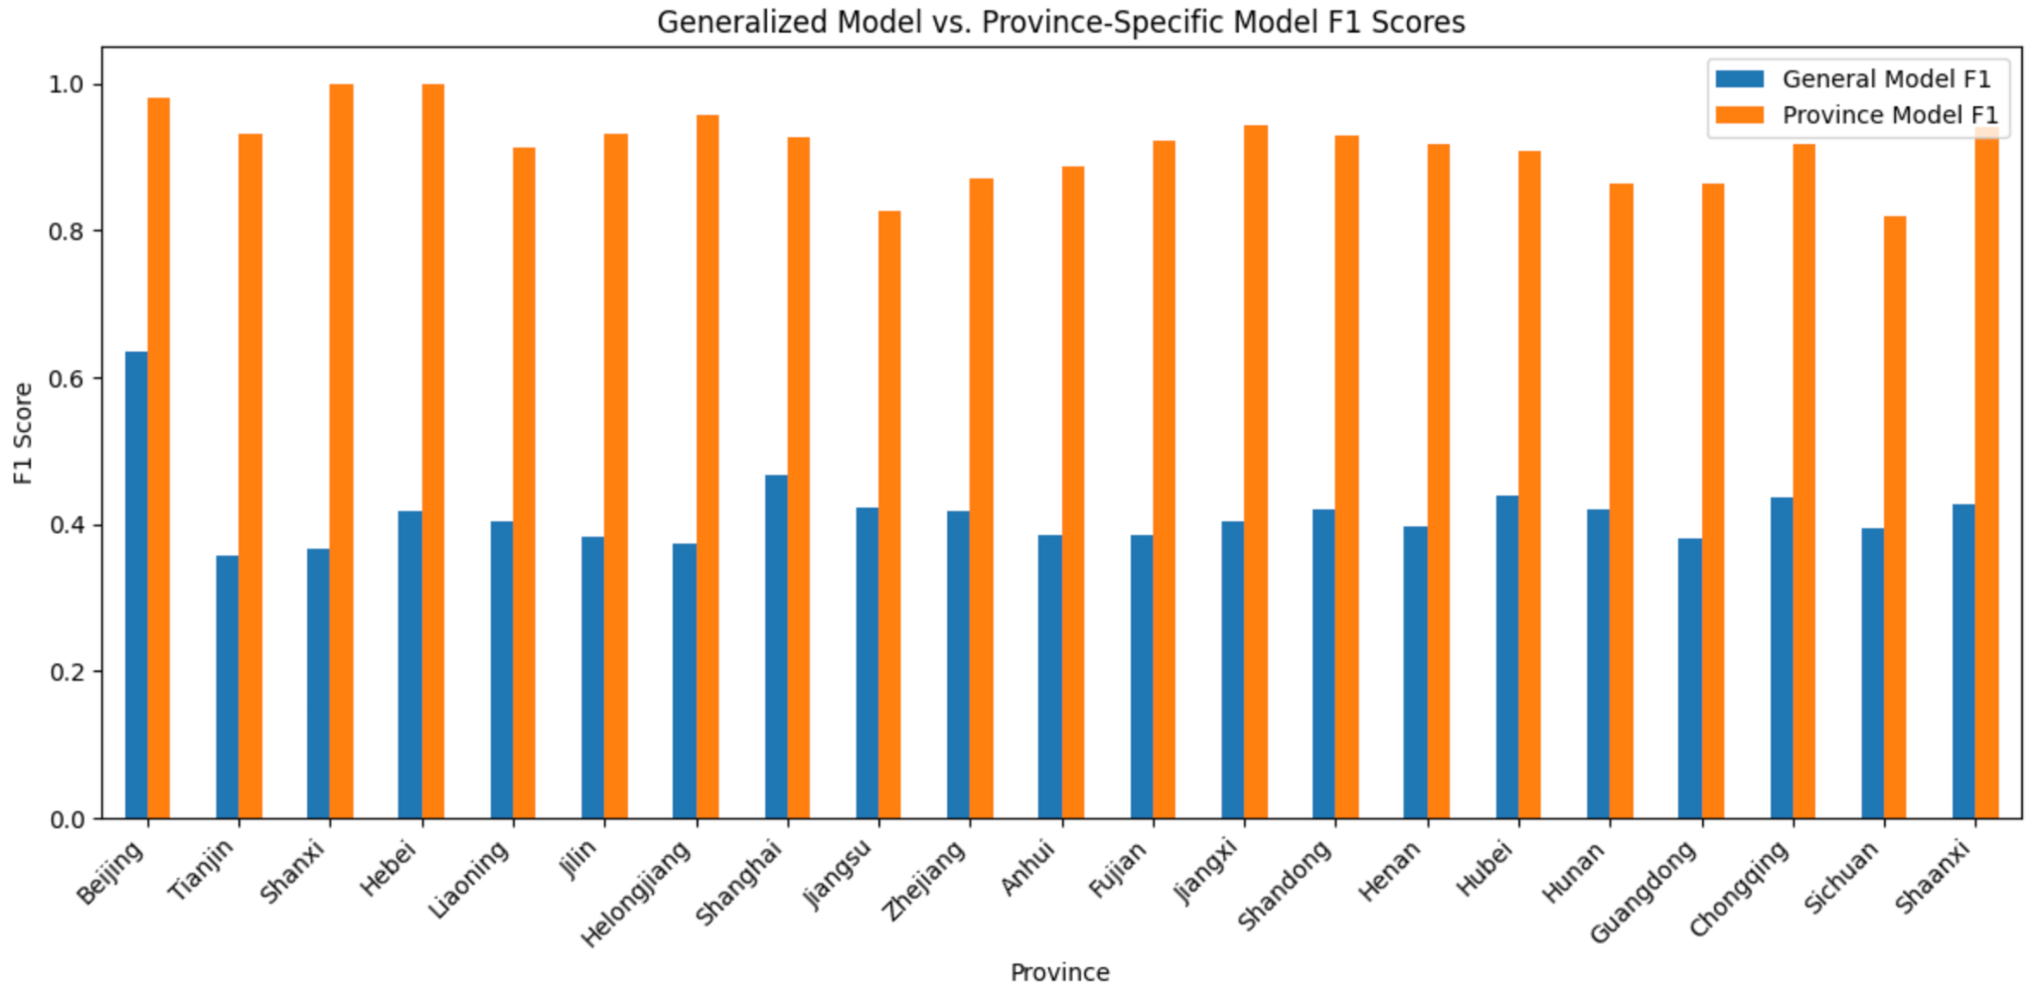
Model Recalibration
Observed Results: Using Post-Stratification to compare two distributions

Slide 34
What’s Next
Evaluate Post-Stratification on feature sets
Explore Propensity Score to effect of aging by taking into consideration different set of features as covariates
Integrated Analysis to encourage certain Life Styles and Habits for better and long life

Slide 35
Thank You
Questions!

